Slide 1
Hack and Crack - #Journey2Salesforce
Khyati Mehta, Salesforce Developer
@khyatu07 | khyatumehta6@gmail.com
Sirigowri N A, Salesforce Developer
@SirigowriNA | Sirigowrina@gmail.com

Slide 2
Crack LWC with us
Project Management Application
Contents
Introduction to LWC
Data Model - Project Management
Demo
Technical Overview
Advantages of building reusable components
Future Enhancements
Useful Resources

Slide 3
What is LWC?
The power of Lightning Web Components is the templating system, which uses the virtual DOM to render components smartly and efficiently. It’s a best practice to let LWC manipulate the DOM instead of writing JavaScript to do it

Slide 4
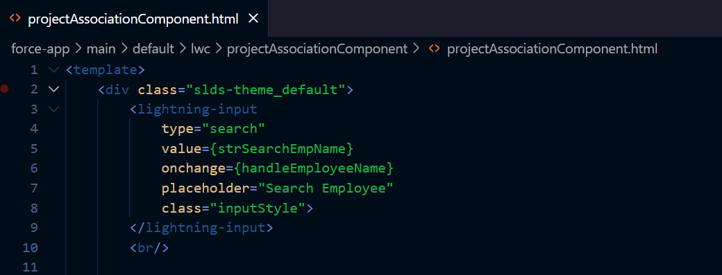
HTML

Slide 5
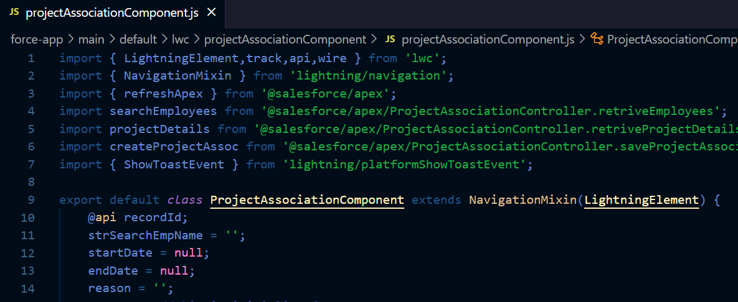
JavaScript

Slide 6
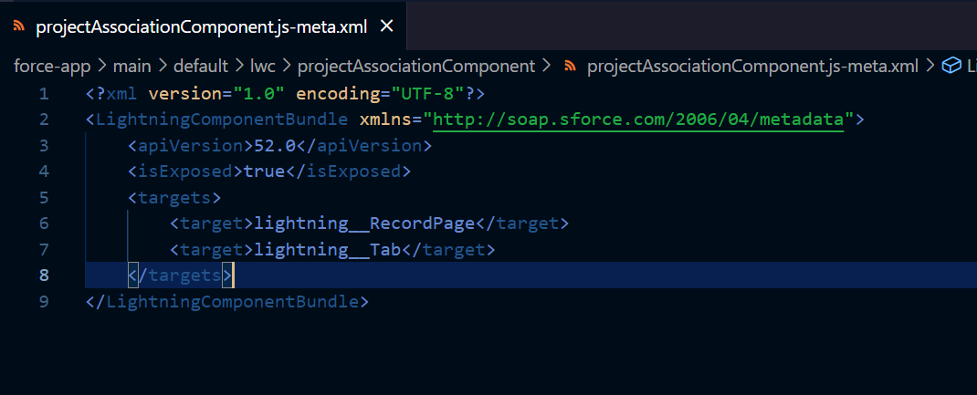
Meta.xml

Slide 7
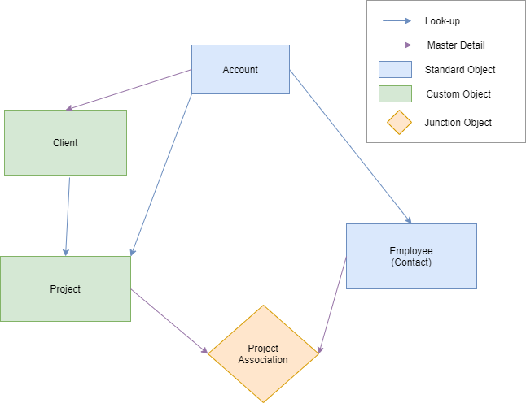
Data Model
Project Management Application

Slide 8
DEMO

Slide 9
Project Mapping Component
Design & Technical Overview
Wiring Apex
Lightning Datatable
Pagination
Custom Events

Slide 10
Project Mapping Component
Design & Technical Overview
Reusable Modal Component
Imperative Apex
Toast Messages
Apex Class for Saving the Project Association Records

Slide 11
Advantages of building reusable components
Less Development Efforts
Use the same component multiple times
Time Saving
Increases Productivity

Slide 12
Best Practices
Use Debug Mode while developing Lightning Components. (not recommended in higher environments)
Create reusable components.
Use @wire over imperative whenever possible
Do not use style tag in HTML instead create a CSS File.
Break the components to small parts

Slide 13
Best Practices
Use custom events to pass data from child to parent.
Use public properties to pass data from parent to child.
Use styling hooks instead of !important in CSS
Errors should pass from child to parent.

Slide 14
Future Enhancements
Creating reusable custom datatable
Add ordering and sorting to datatable
Adding a custom filter component
Option to select employees based on their role
Adding feedback Module

Slide 15
Where can you find our code?
https://github.com/Sirigowri/Crack_LWC_With_Us

Slide 16
Useful Resources
Available for Learning LWC
Component Library
Sample Gallery
lwc.dev
Salesforce Documentation
YouTube Videos from Salesforce Developers Channel
Trailhead

Slide 17
Any Questions??

